Slide 1

Federal Funds Target Rate Prediction via FOMC Speech
Korea University
Department of Industrial Management Enginerring
Data Mining Laboratory
TEAM 3
Park Youngjoon, Lee Hankyu, Do Hyungrok
Dioxin

Slide 2

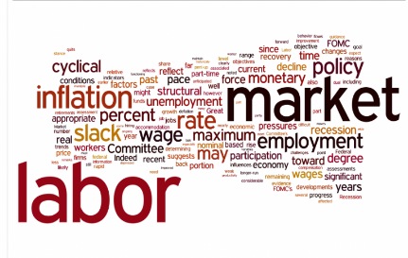


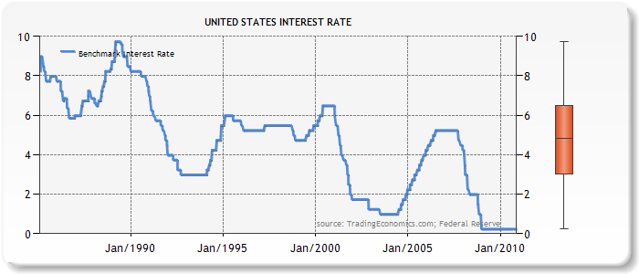

Research Objective
From the speeches, we will construct a classification model to predict the federal funds rate after the speech, whether it goes up, down or stay.
Construct Classification Model
Predict Federal Funds Rate
Collect Data
UP
DOWN
…
…
STAY
FOMC Speech
&
Federal Funds Rate
Deep Learning Approach
3-Class Classification

Slide 3
Outline
Data Collection
Preprocessing
Classification
Federal Fund Target Rate
Speech Labeling
Class Imbalance
FOMC Speech
Text Vectorization
Lemmatization
Parsing
(Uni/Bi-gram)
Classification Algorithms
Dimensionality Reduction
TF-IDF
Stacked Auto Encoder

Slide 4

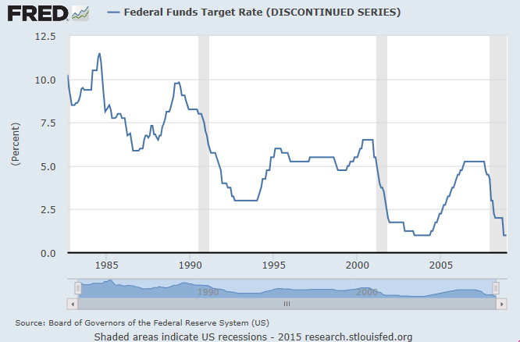
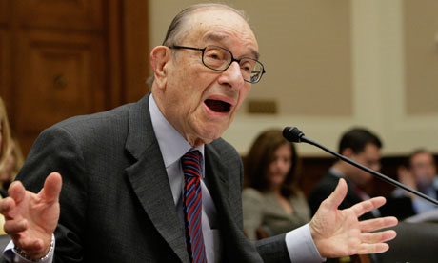
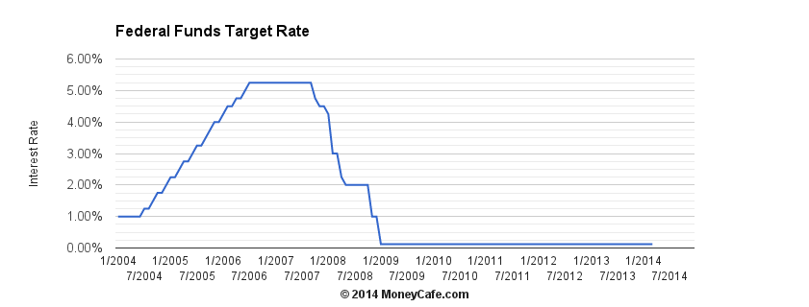
Data Description
FOMC Speech Data
Federal Funds Target Rate Data
Crawled from Federal Reserve System website
From 1996 to 2015, total 1,159 speeches are collected
Speechs have – words on average
Downloaded from Federal Reserve Economic Data System of St. Louis
From 1996 to 2008, total – of daily target rates are collected
After 2008, there was no change of target rate, therefore we did not use

Slide 5
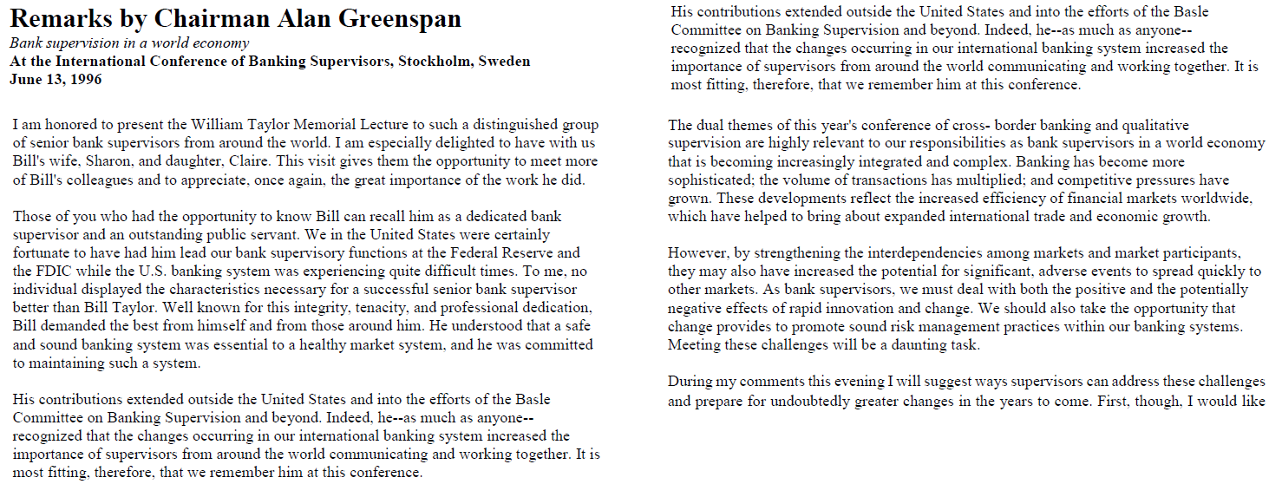
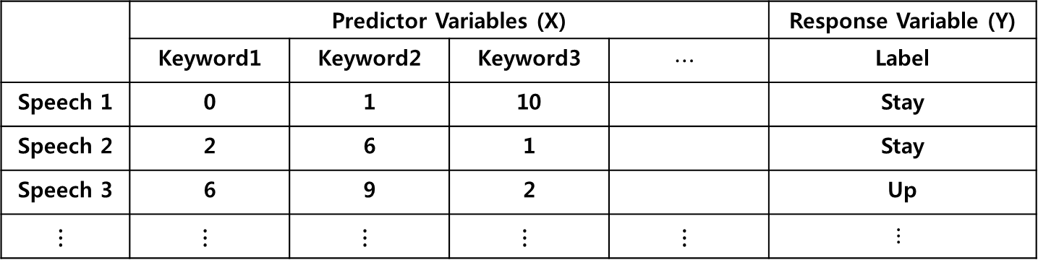
Data Preprocessing
Outline
Text Vectorization
Speech Labeling
 | Predictor Variables (X) |  |  |  | Response Variable (Y)
 | Keyword1 | Keyword2 | Keyword3 | $$⋯$$ | Label
Speech 1 | 0 | 1 | 10 |  | Stay
Speech 2 | 2 | 6 | 1 |  | Stay
Speech 3 | 6 | 9 | 2 |  | Up
$$⋮$$ | $$⋮$$ | $$⋮$$ | $$⋮$$ | $$⋮$$ | $$⋮$$

Slide 6
Data Preprocessing
Speech Labeling
We labeled speeches of 1996 ~ 2008 using the target rate data by comparing the average of target rate before and after 2 weeks from the speech
Average Rate
After 2 weeks 5.46
Average Rate
Before 2 weeks: 5.25
5.25 → 5.46
Target rate increased !
Therefore the label of this speech is UP
Speech
UP | STAY | DOWN
114 | 613 | 126
Number of speeches in each class

Slide 7
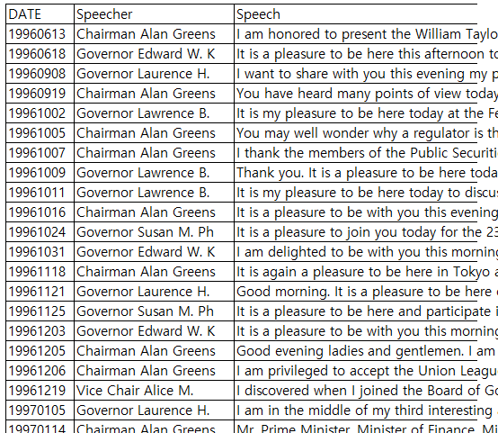
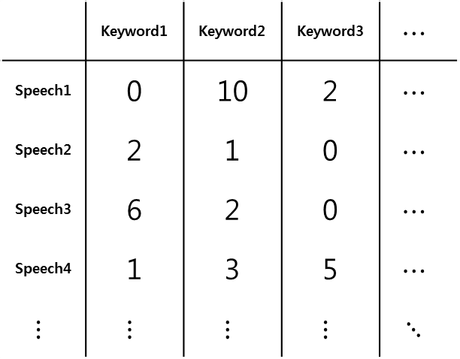
Data Preprocessing
Text Vectorization
Packages koRpus, tm, RWeka in R are employed for lemmatization, uni-gram parsing, bi-gram parsing respectivey
We got more than 800,000 keywords
800,000
 | Keyword1 | Keyword2 | Keyword3 | $$⋯$$
Speech1 | 0 | 10 | 2 | $$⋯$$
Speech2 | 2 | 1 | 0 | $$⋯$$
Speech3 | 6 | 2 | 0 | $$⋯$$
Speech4 | 1 | 3 | 5 | $$⋯$$
$$⋮$$ | $$⋮$$ | $$⋮$$ | $$⋮$$ | $$⋱$$
Lemmatization
Parsing Uni/Bi-gram

Slide 8
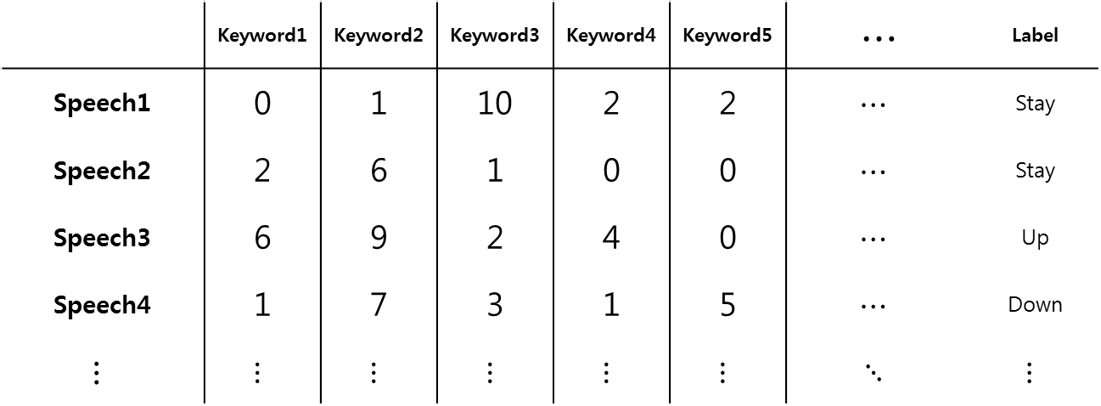
Data Preprocessing
Summary
Finally, we obtained 853 by 800,000 data matrix
800,000 keywords
 | Keyword1 | Keyword2 | Keyword3 | Keyword4 | Keyword5 | $$⋯$$ | Label
Speech1 | 0 | 1 | 10 | 2 | 2 | $$⋯$$ | Stay
Speech2 | 2 | 6 | 1 | 0 | 0 | $$⋯$$ | Stay
Speech3 | 6 | 9 | 2 | 4 | 0 | $$⋯$$ | Up
Speech4 | 1 | 7 | 3 | 1 | 5 | $$⋯$$ | Down
$$⋮$$ | $$⋮$$ | $$⋮$$ | $$⋮$$ | $$⋮$$ | $$⋮$$ | $$⋱$$ | $$⋮$$
853
Speeches

Slide 9
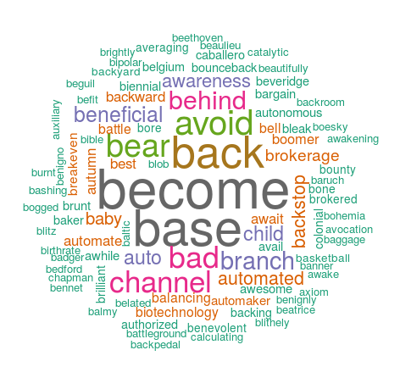
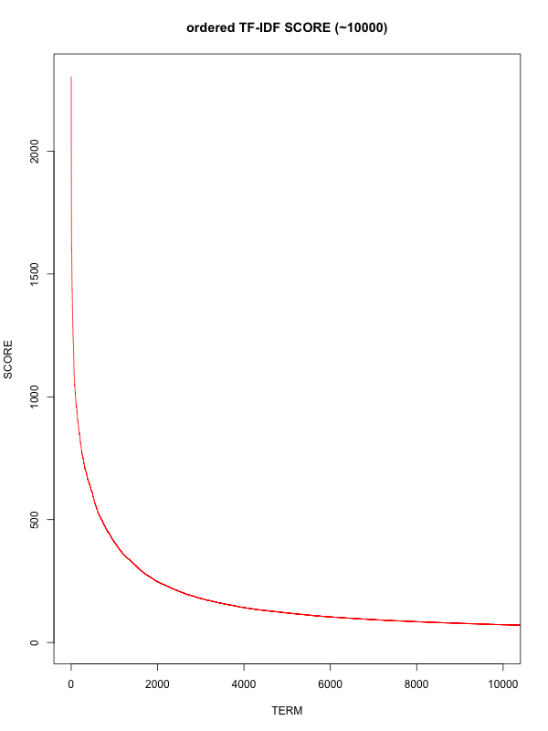
Dimensionality Reduction
Feature Selection & Extraction
Feature selection
TF-IDF SCORE plot
5,000 keywords
we select 5000 keyword using TF-IDF score

Slide 10
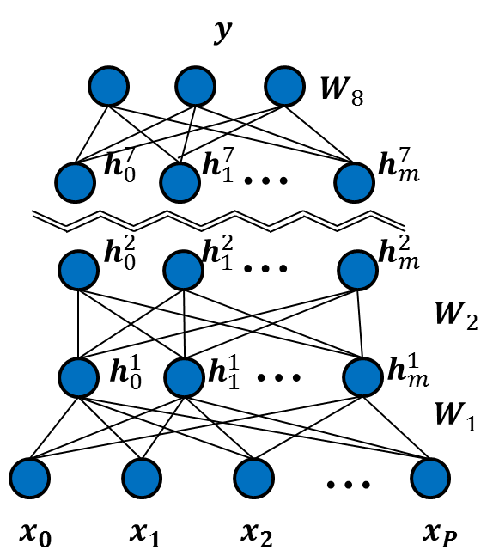
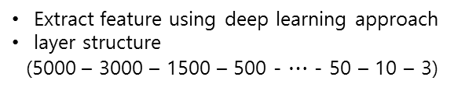
Dimensionality Reduction
Feature Selection & Extraction
Feature extraction
Selected feature (5,000)
Extract feature using deep learning approach
layer structure
(5000 – 3000 – 1500 – 500 - $⋯$ - 50 – 10 – 3)

Slide 11

Results
Classificaiton Algorithm | Accuracy
 | 100 | 50 | 10 | 3
KNN(k=16) | 36.7% | 37.0% | 40.1% | 35.9%
naïve bayes | 30.7% | 26.8% | 48.8% | 46.5%
Random Forest | 36.2% | 36.7% | 36.1% | 33.0%
Decision Tree | 37.8% | 33.6% | 38.5% | 24.6%
SVM(Radial basis) | 36.2% | 31.5% | 29.4% | 48.0%
Naïve Bayes |  | Prediction
 |  | UP | STAY | DOWN
Actual | UP | 6 | 19 | 9
 | STAY | 66 | 272 | 195
 | DOWN | 8 | 17 | 21
SVM |  | Prediction
 |  | UP | STAY | DOWN
Actual | UP | 26 | 20 | 0
 | STAY | 264 | 268 | 1
 | DOWN | 16 | 18 | 0

Slide 12
Conclusions
FOMC speech does not provide enough information to predict the target fund rates
Training error 60%
There possibly exists other factors except FOMC speech
Training set biased model
Training error: 60% vs testing error: 40%
Transitions of target fund rate are challenging
Contemporary machine learning algorithms cannot surpass human brain

Slide 13


